Slide 1
CHAPTER 8
Statistical Inference
○ Point Estimation
○ Confidence Interval Estimation
○ Hypothesis Testing

Slide 2
CHAPTER 8
Chapter 8: Inferences Based on a Single
Sample: Tests of Hypotheses
8.1 The Elements of a Test of Hypothesis
8.2 Formulating Hypotheses and Setting Up the Rejection Region
8.3 Test of Hypotheses about a Population Mean: Normal (z) Statistic

Slide 3
Hypothesis Testing
Example: We might need to decide whether the mean
weight of all bags of ecclairs packaged by a particular
company differs from the advertised weight of 454
grams.
One of the most commonly used methods for making such
decisions or judgments about a specific value of a population
parameter is to perform a hypothesis test.
Hypothesis:
A hypothesis is a statement that something is true.
Example: The statement “the mean weight of all bags of pretzels
packaged differs from the advertised weights of 454 grams” is a
hypothesis.
Statistical Hypothesis:
A statistical hypothesis is a conjecture about a
population parameter.
A Test is a rule to check a hypothesis.

Slide 4
CHAPTER 8
Setting up the hypotheses:
Clearly state both the null hypothesis and the alternative hypothesis using the appropriate symbols and also describing the claims in words expressing the context of the current problem. (You must have both the verbal and symbolic form.)
Remember, hypotheses are always in terms of the parameter (eg., μ, p, etc. ) NOT the statistic (eg., etc.)

Slide 5
CHAPTER 8
Null Hypothesis:
- It is denoted by H₀.
It is a hypothesis to be tested, and the decision is based
on the null hypothesis.
- It is a statement of “no effect” , or “no difference”, or
“the difference is null”.
- If the original claim includes equality (=) it is
the null hypothesis. If the original claim does not
include equality ( <, ≠, > ), then the null hypothesis is
the complement of the original claim. The null
hypothesis always includes the equal sign.

Slide 6
CHAPTER 8
Alternative Hypothesis:
- It is denoted by H_{a} or H₁
- It is a statement which is true if the null hypothesis is
false
-Alternative hypothesis can be <,>,≠ type.
- The type of test (left-tail, right-tail, or two-tail is based
on the alternative hypothesis
- It is also called research hypothesis.

Slide 7
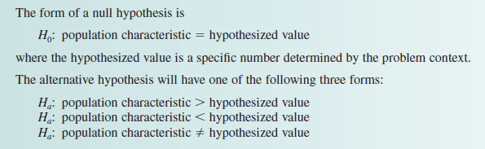
CHAPTER 8
H₀: µ = µ₀
H_{a}: µ < µ₀
H_{a}: µ ≠ µ₀
H_{a}: µ > µ₀
The null hypothesis is
usually stated as an
equality …
… even though the alternative hypothesis can be either an equality or an inequality.
( e.g., H0: μ = 454 gram )
( e.g., Ha: μ >454 )
( e.g., Ha: μ < 454 )
( e.g., Ha: μ ≠ 454 )

Slide 8
CHAPTER 8
Identifying Hypotheses
Example: Teenagers (age 15 to 20) make up 7% of the driving population. The article “More States Demand Teens Pass Rigorous Driving Tests” (San Luis Obispo Tribune, January 27, 2000) described a study of auto accidents conducted by the Insurance Institute for Highway Safety. The Institute found that 14% of the accidents studied involved teenage drivers. Suppose that this percentage was based on examining records from 500 randomly selected accidents. Does the study provide convincing evidence that the proportion of accidents involving teenage drivers differs from .7, the proportion of teens in the driving population? Use α =.05.

Slide 9
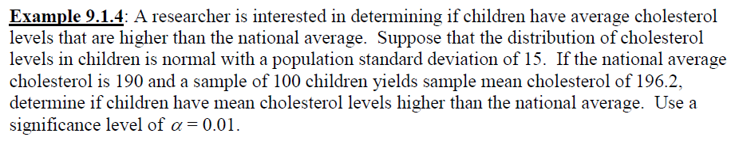
CHAPTER 8
Identifying Hypotheses
:

Slide 10
Identifying Hypotheses
A metal lathe is checked periodically by quality control inspectors to
determine whether it is producing machine bearings with a mean
diameter of .5 inch. If the mean diameter of the bearings is larger or smaller
than .5 inch, then the process is out of control and must be adjusted.
Formulate the null and alternative hypotheses for a test to determine
whether the bearing production process is out of control.

Slide 11
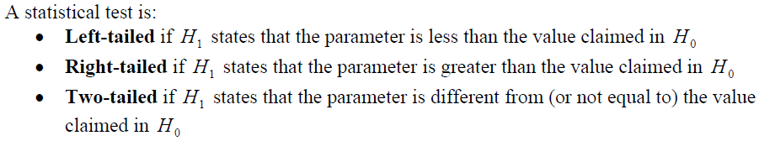
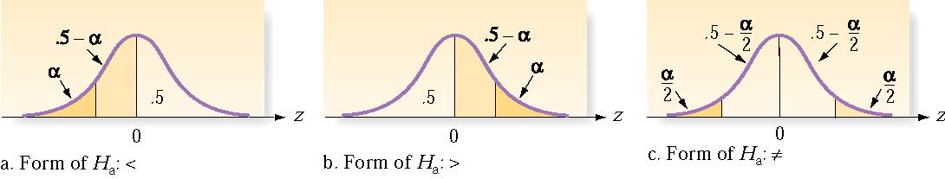
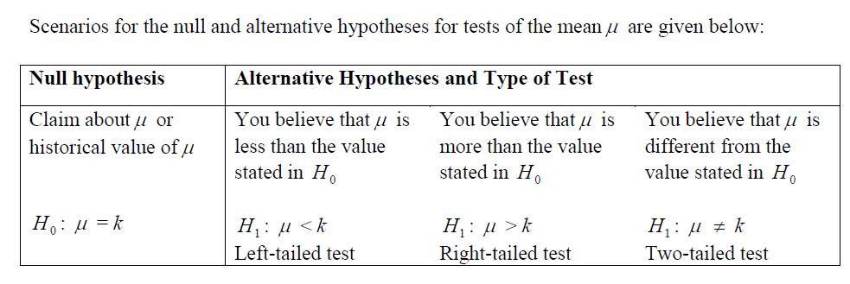
CHAPTER 8

Slide 12
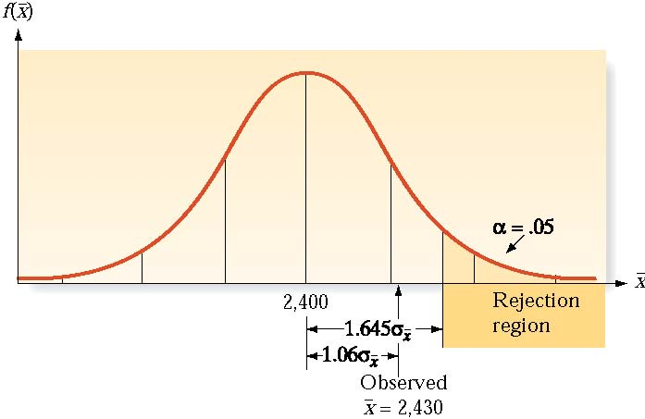
CHAPTER 8
If the test statistic has a high probability when H₀ is true, then H₀ is not rejected.
If the test statistic has a (very) low probability when H₀ is true, then H₀ is rejected.

Slide 13
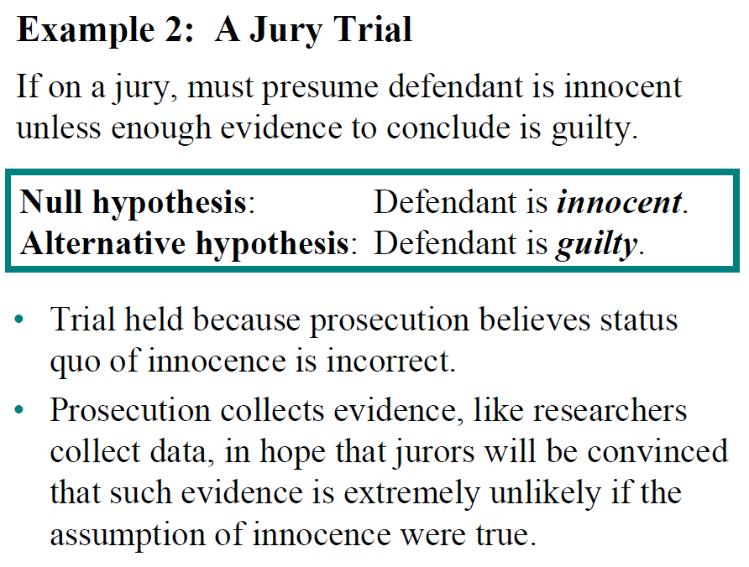
CHAPTER 8
Errors in Hypothesis Testing

Slide 14
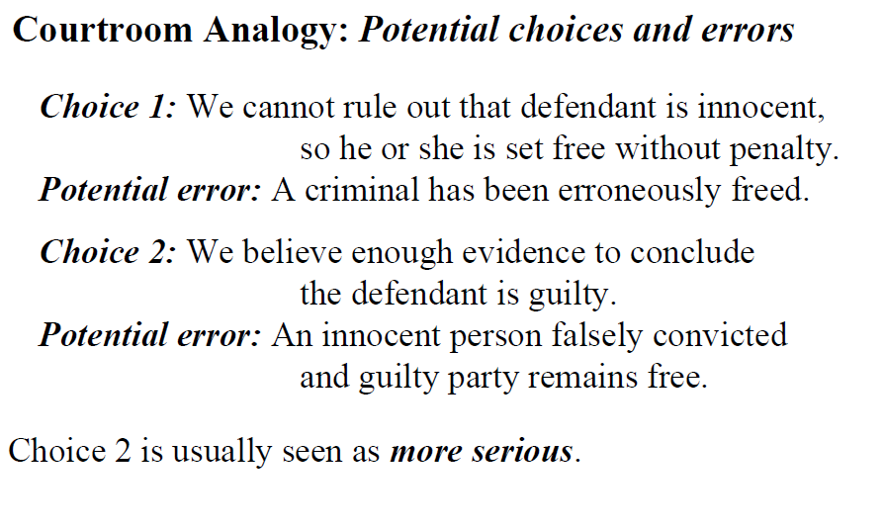
CHAPTER 8

Slide 15
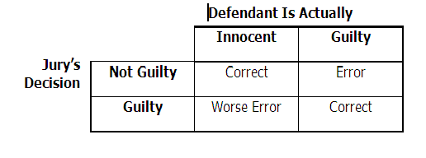
CHAPTER 8
The Reasoning of Hypothesis Testing is Often Compared to that of a Jury Trial
Each trial actually has 4 potential decisions – two are correct decisions, two are errors.
Possible decisions are based on:
the reality about the defendant’s innocence or guilt;
the decision that the jury makes based on the evidence

Slide 16
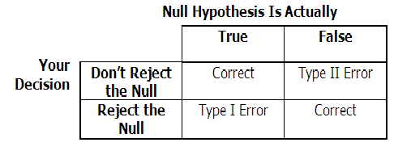
CHAPTER 8
The Reasoning of Hypothesis Testing is Similar
Each test has 4 potential decisions – two are correct decisions, two are errors.
Possible decisions are based on:
the reality about the null hypothesis;
your decision based on the evidence from the sample.

Slide 17
CHAPTER 8
Type I & Type II Errors
Type I error: we reject H₀ when in fact H₀ is true
The significance level,α, of a test is the probability of a Type I error.
Thus, a test with α = 0.01 is said to have a level of significance of 0.01 or to be a level 0.01 test.
We control the probability of making a Type I error, which gives credibility to our decision if we decide to reject H₀ in favor of H_{a} .
Type II error: we fail to reject H₀ when in fact H₀ is false.
Decreasing the chance of a type I error can increase the chance of a type II error.
The probability of a type II error is denoted by β.

Slide 18
CHAPTER 8
Steps to do Hypothesis Testing:
Hypotheses: Formulate the null hypothesis (H₀) and alternative
hypothesis (H_{a}).
Test Statistic: Clearly identify the test statistic to be used to test the hypothesis and why it is reasonable to use this test. All required assumptions must be satisfactorily addressed in this step.
Level of significance: It is denoted by α (alpha) and chosen to be α equal to 0.01, 0.05, or 0.10. It is the probability of rejecting the null hypothesis when it is true. α can be treated as the complement of the level of confidence in estimation.
Rejection region: The values for the test statistic which lead to rejection of the null hypothesis. OR, p-value (section 3.3)

Slide 19
CHAPTER 8
Calculation of test statistic: The appropriate calculation for
the test based on the sample data.
Decision and Conclusion: Reject the null hypothesis (with possible Type I error) or do not reject it (with possible Type II error)
Always provide a conclusion that is in the context of the problem and that answers the original research question which the hypothesis test was designed to answer.

Slide 20
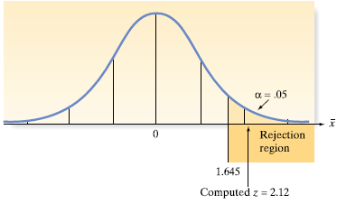
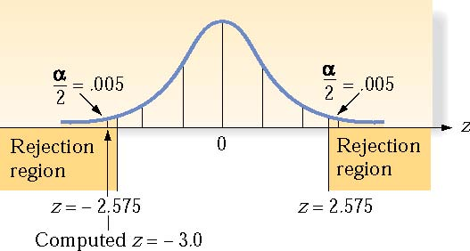
CHAPTER 8
Rejection Regions for Common Values of α
for large sample z-test
 | Lower Tailed | Upper Tailed | Two tailed
α = .10 | z < - 1.28 | z > 1.28 | z<-1.645 or z > 1.645
α = .05 | z < - 1.645 | z > 1.645 | z <-1.96 or z > 1.96
α = .01 | z < - 2.33 | z > 2.33 | z<-2.575 or z > 2.575
Examples
α =.05 (Upper Tailed Test) α =.01 (Two Tailed Test)

Slide 21
How to write the conclusion?
Conclusions are based on the original claim, which may be the null or alternative hypotheses.
Decision | Original Claim
 | H₀ “Reject” | H_{a} “Support”
Reject H₀ “sufficient” | We conclude that there is sufficient evidence at …% level of significance to reject the claim that…… | We conclude that there is sufficient evidence at …% level of significance to support the claim that……
Fail to reject H₀ “insufficient” | We conclude that there is insufficient evidence at …% level of significance to reject the claim that…… | We conclude that there is insufficient evidence at …% level of significance to support the claim that……

Slide 22
CHAPTER 8
8.3 Test of Hypotheses about a Population Mean: Normal (z) Statistic
Hypotheses:
Let μ be the population mean.
Null Hypothesis, H0: μ = μ₀, a specified value; (in words)
Alternative hypothesis,
Ha: μ > μ₀, a specified value; (in words)
or
Ha: μ < μ₀, a specified value; (in words)
or
Ha: μ ≠ μ₀, a specified value; (in words)

Slide 23
CHAPTER 8
Test Statistic
We will perform a large sample z-test for the population mean.
Conditions:
A random sample is selected from the target population.
The sample size n is large.
Verification of these assumptions makes it reasonable to assume the approximate normality of the sampling distribution of sample mean. Therefore, we can perform the z-test.

Slide 24
CHAPTER 8
Level of significance
α = ??? (usually given, if not choose α =.05)
Rejection Region
if upper tailed test (or Ha: μ>μ₀)
or
if lower tailed test (or Ha: μ< μ₀)
or
if two tailed test (or Ha: μ ≠ μ₀)
Calculation of test statistic

Slide 25
CHAPTER 8
Decision and conclusion
If the calculated value of the proposed test statistic belongs to the rejection region, we reject H₀; otherwise we fail to reject H₀.
Write the conclusion in the context of question.

Slide 26
CHAPTER 8
Example
The effect of drugs and alcohol on the nervous system has been the subject of considerable research. Suppose a research neurologist is testing the effect of a drug on response time by injecting 100 rats with a unit dose of the drug, subjecting each rat to a neurological stimulus, and recording the response time. The sample mean and standard deviation of the response times are 1.05 seconds and .5 second, respectively. The neurologist knows that the mean response time for rats not injected with the drug (the ·control" mean) is 1.2 seconds. She wishes to test whether the mean response time for drug-injected rats differ from 1.2 seconds. Set up the test of hypothesis for this experiment, using α=.01.

Slide 27
CHAPTER 8
i) Hypotheses.

Slide 28
CHAPTER 8
ii) Test Statistic

Slide 29
CHAPTER 8
iii) Level of significance
iv) Rejection Region
v) Calculation of test statistic

Slide 30
CHAPTER 8
vi) Decision and Conclusion

